Slide 1

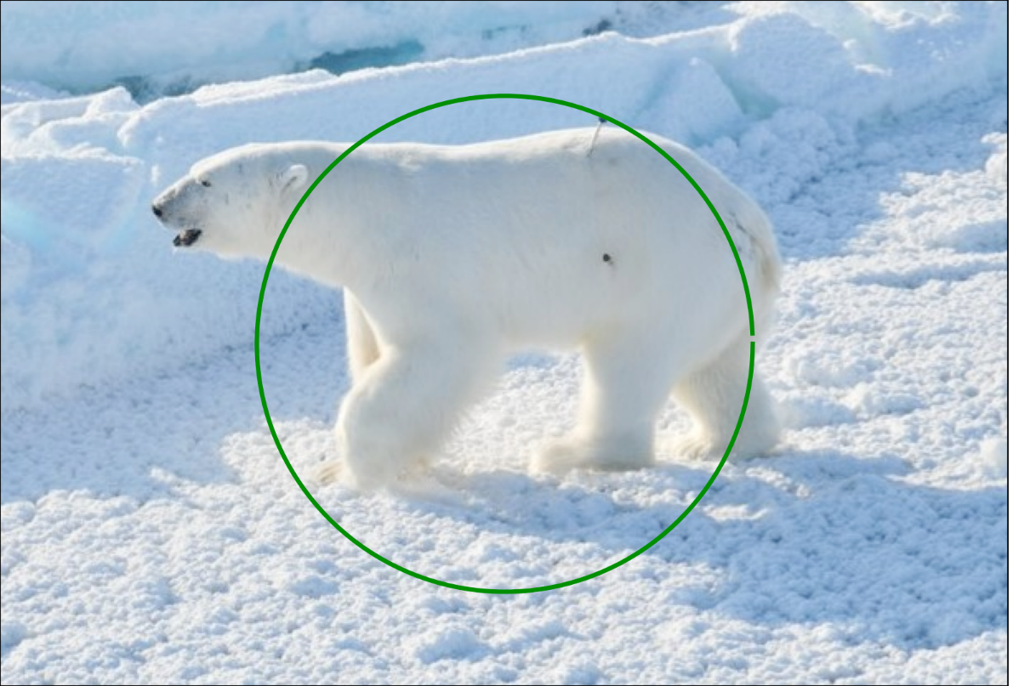
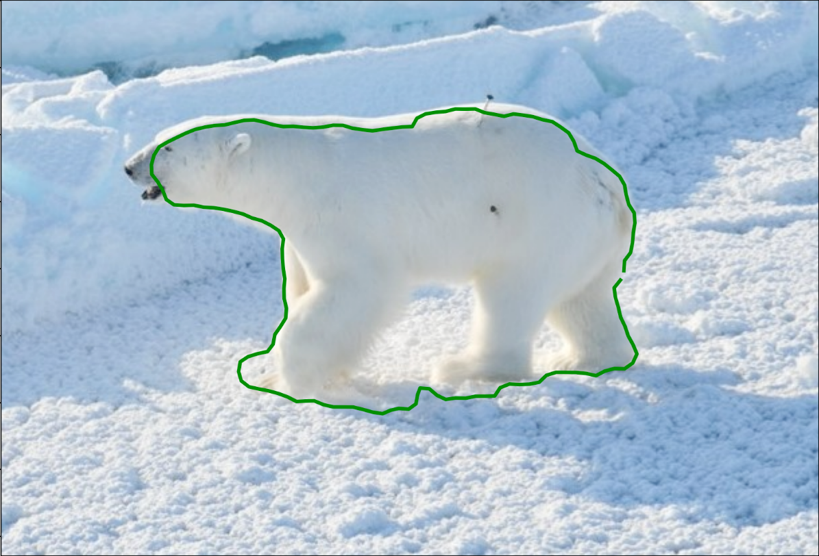
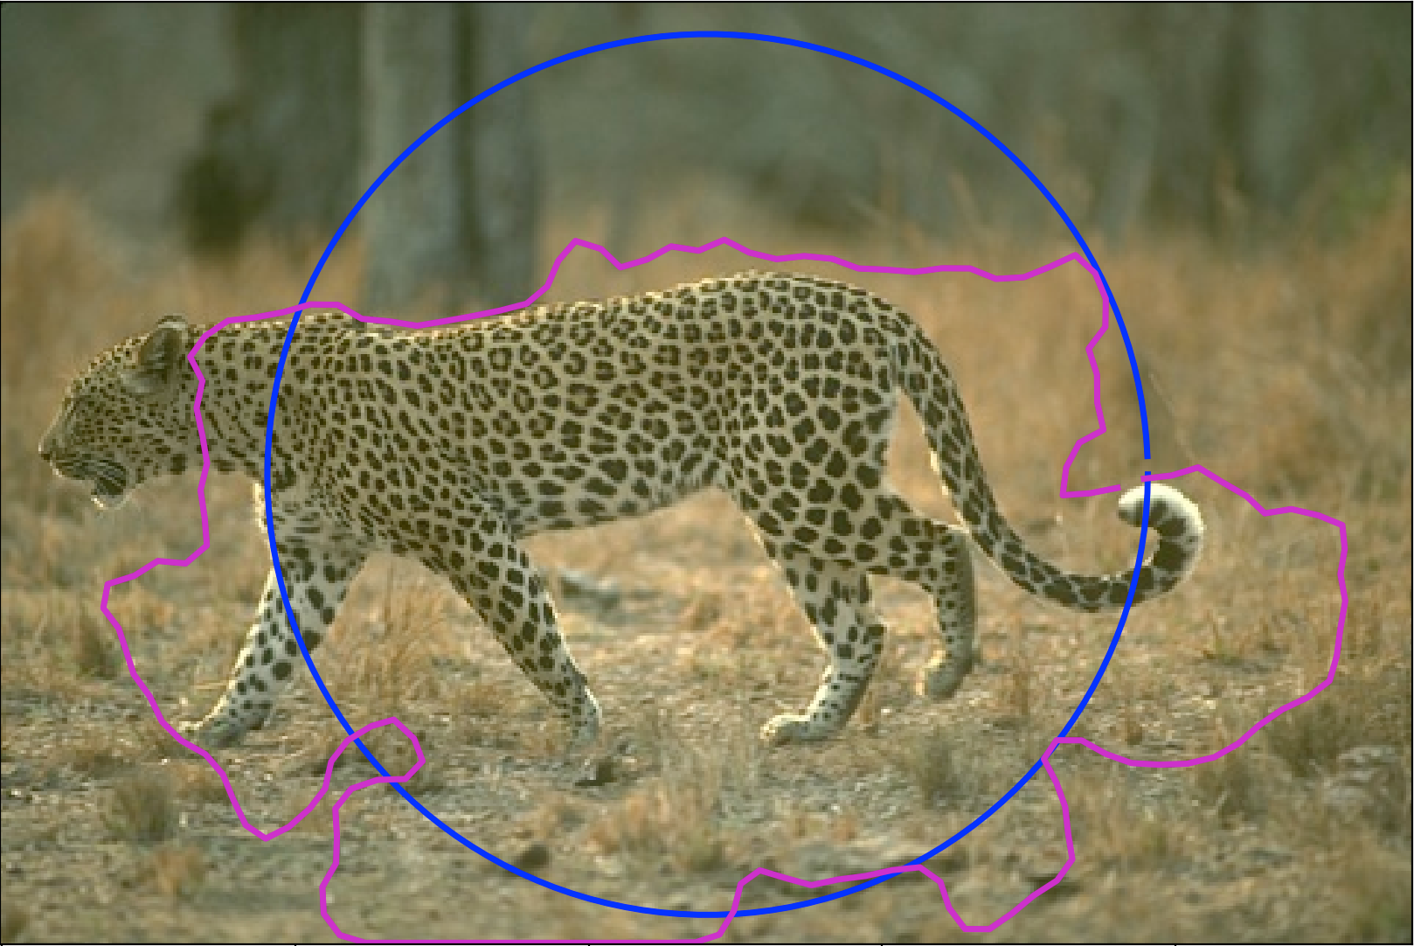
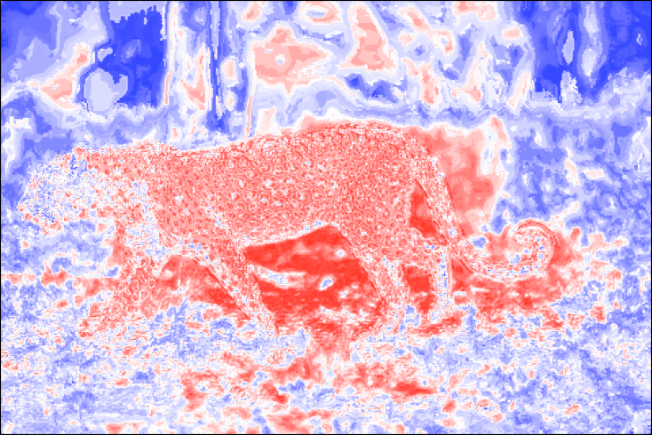
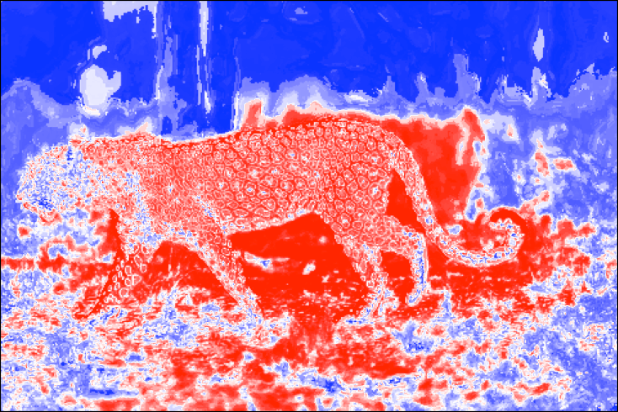
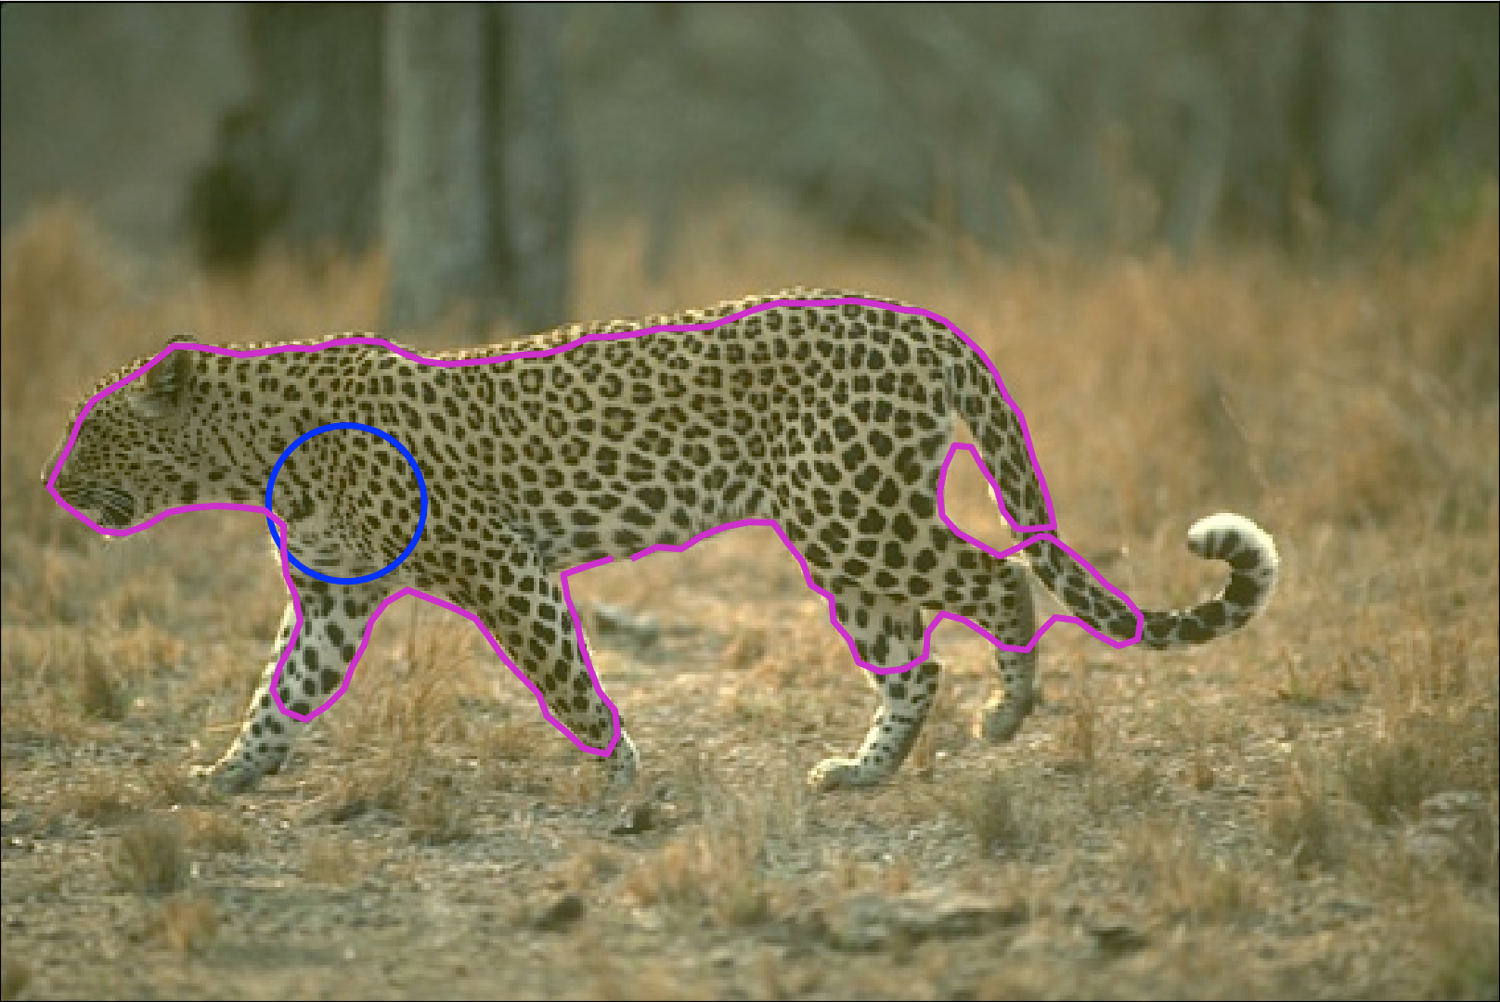
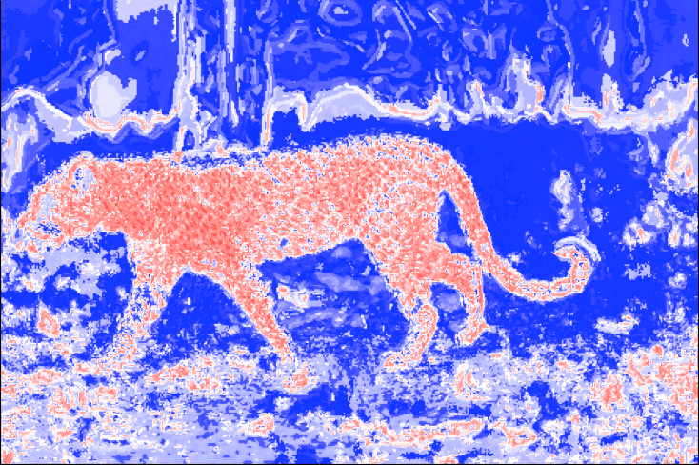
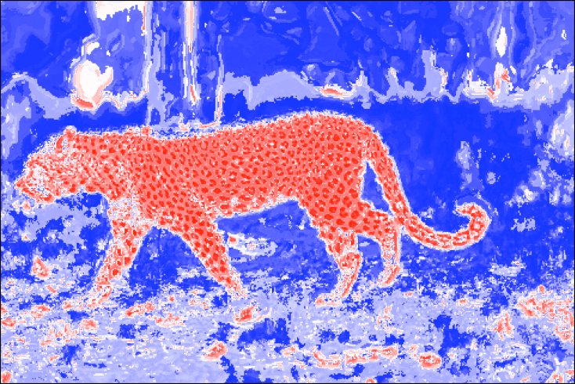
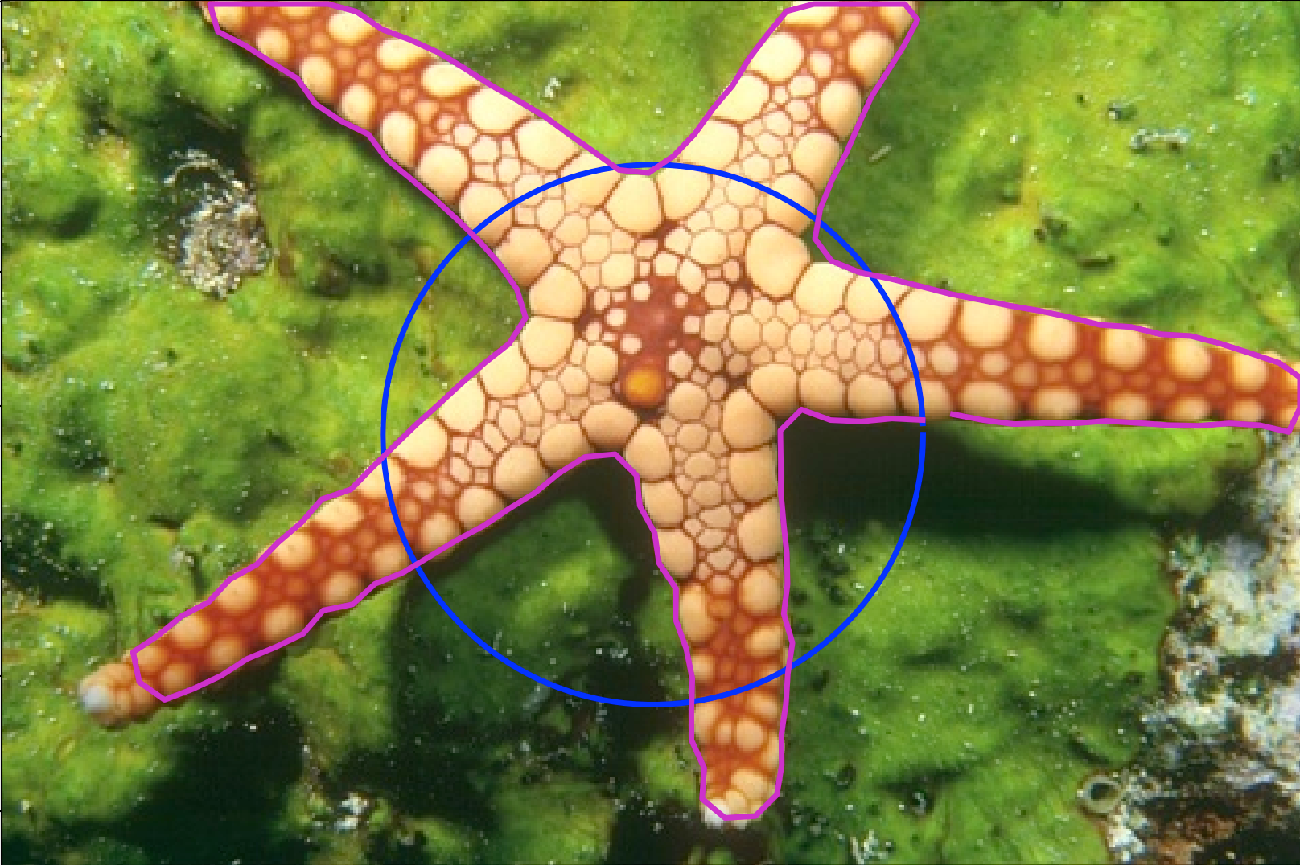
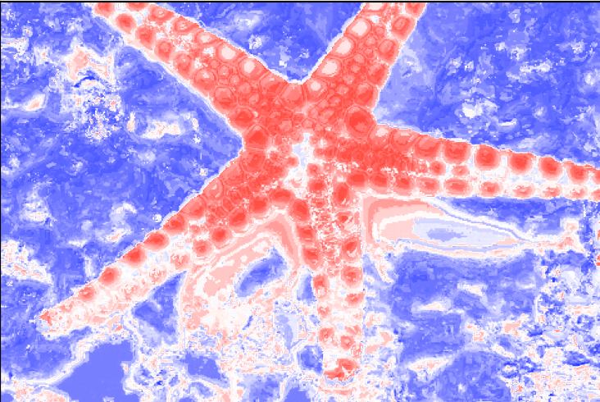
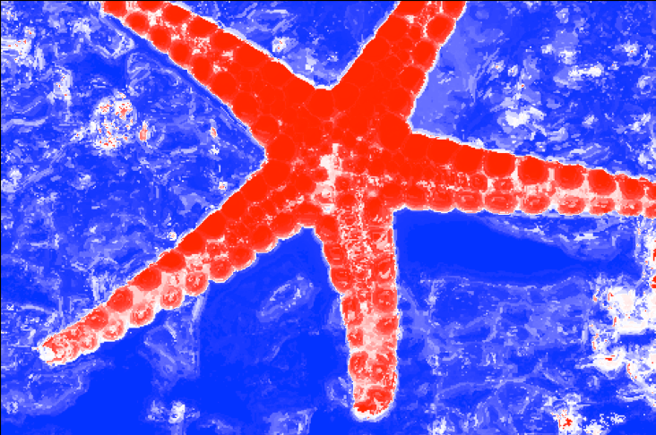
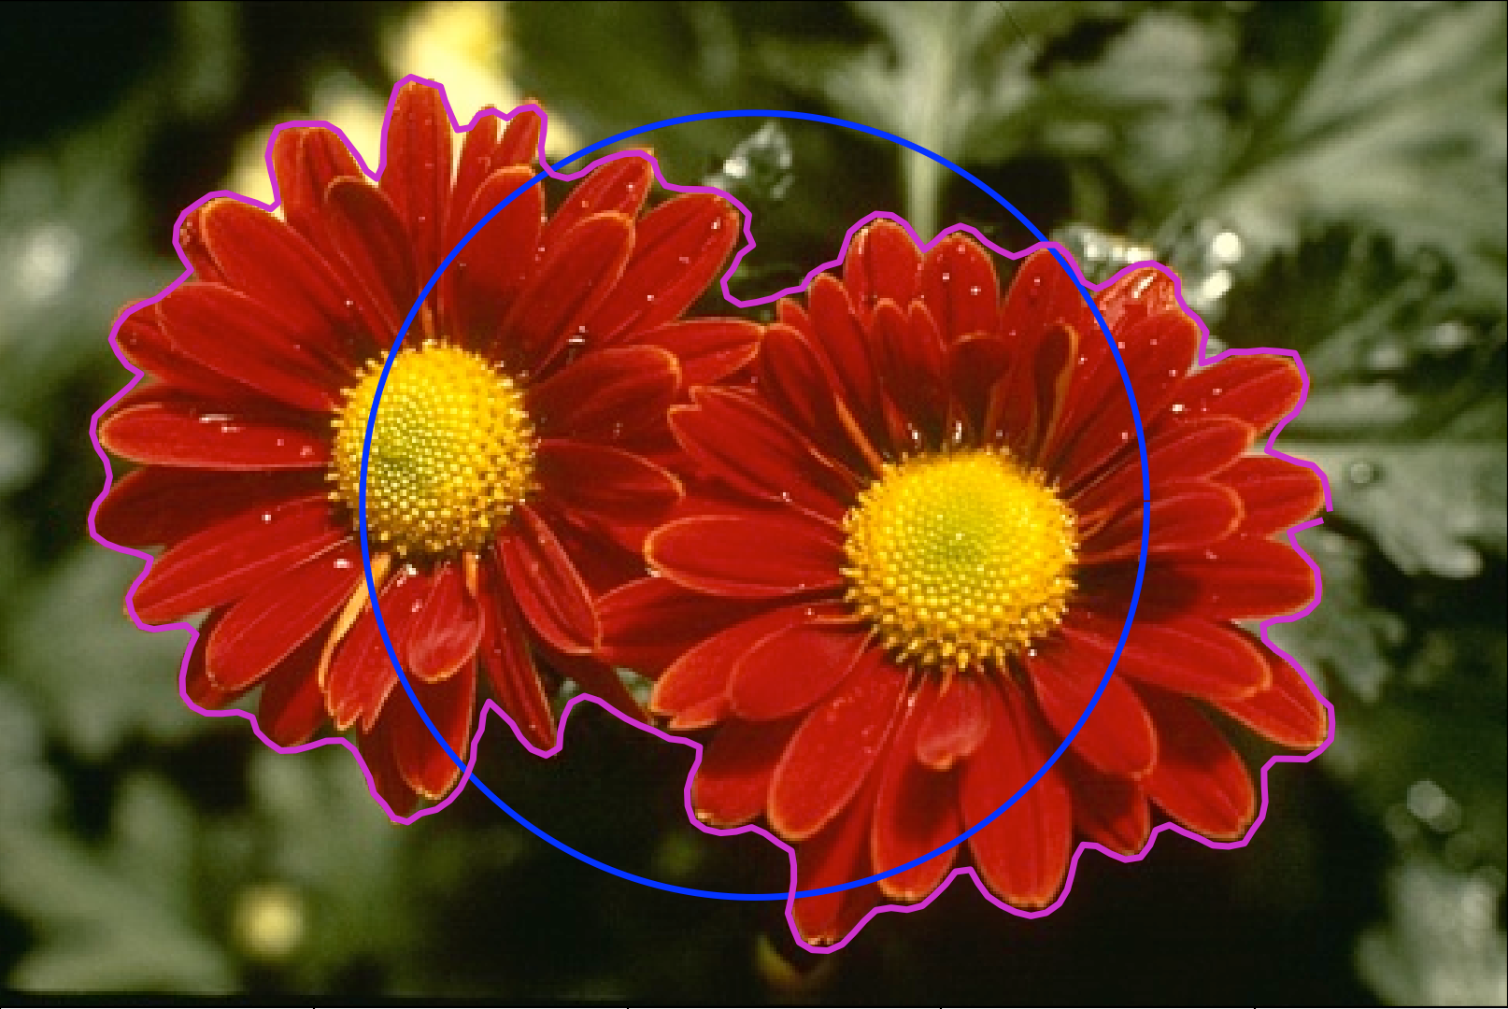
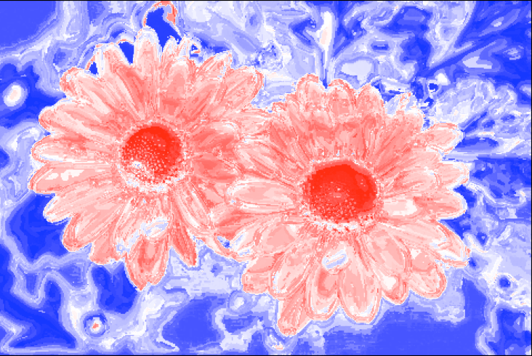
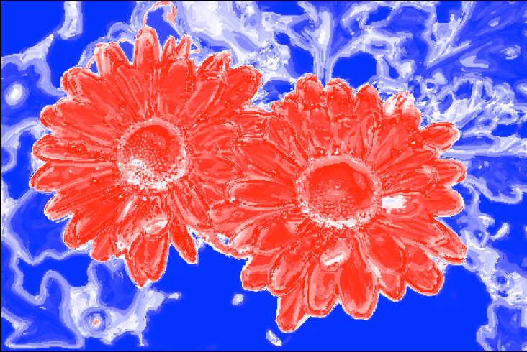
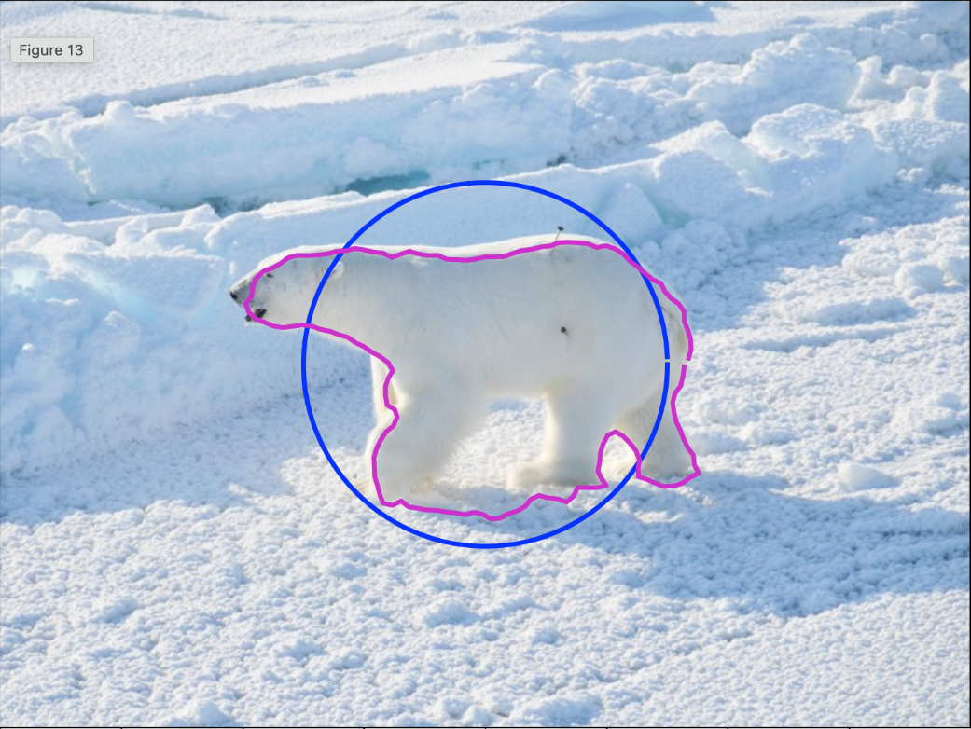
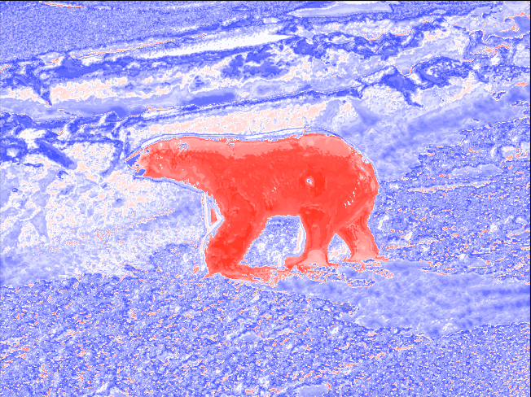
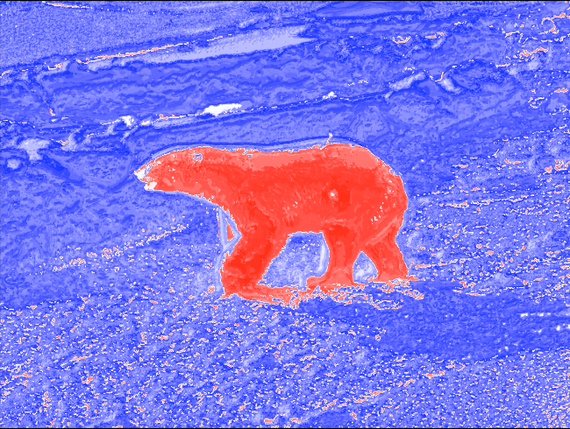
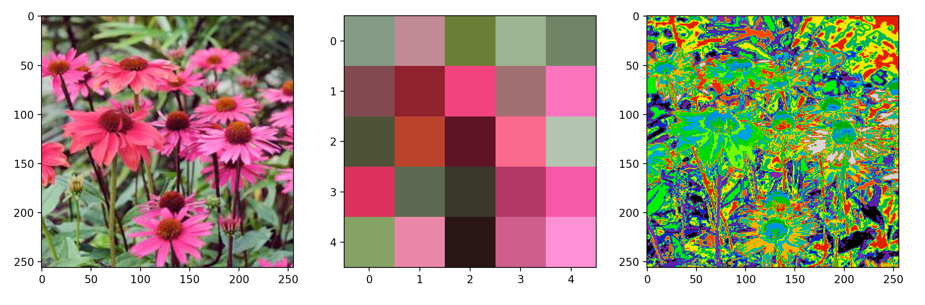
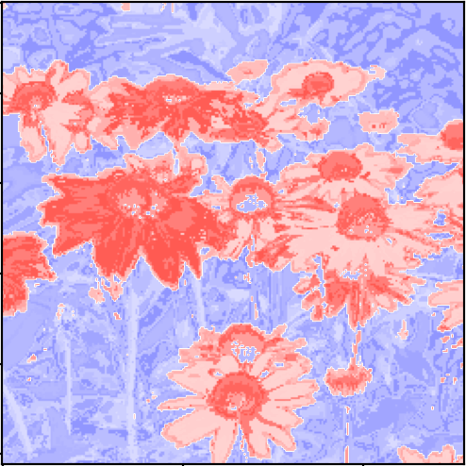
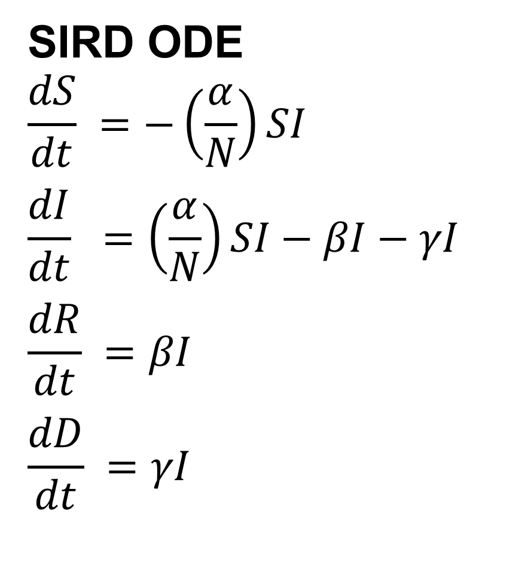
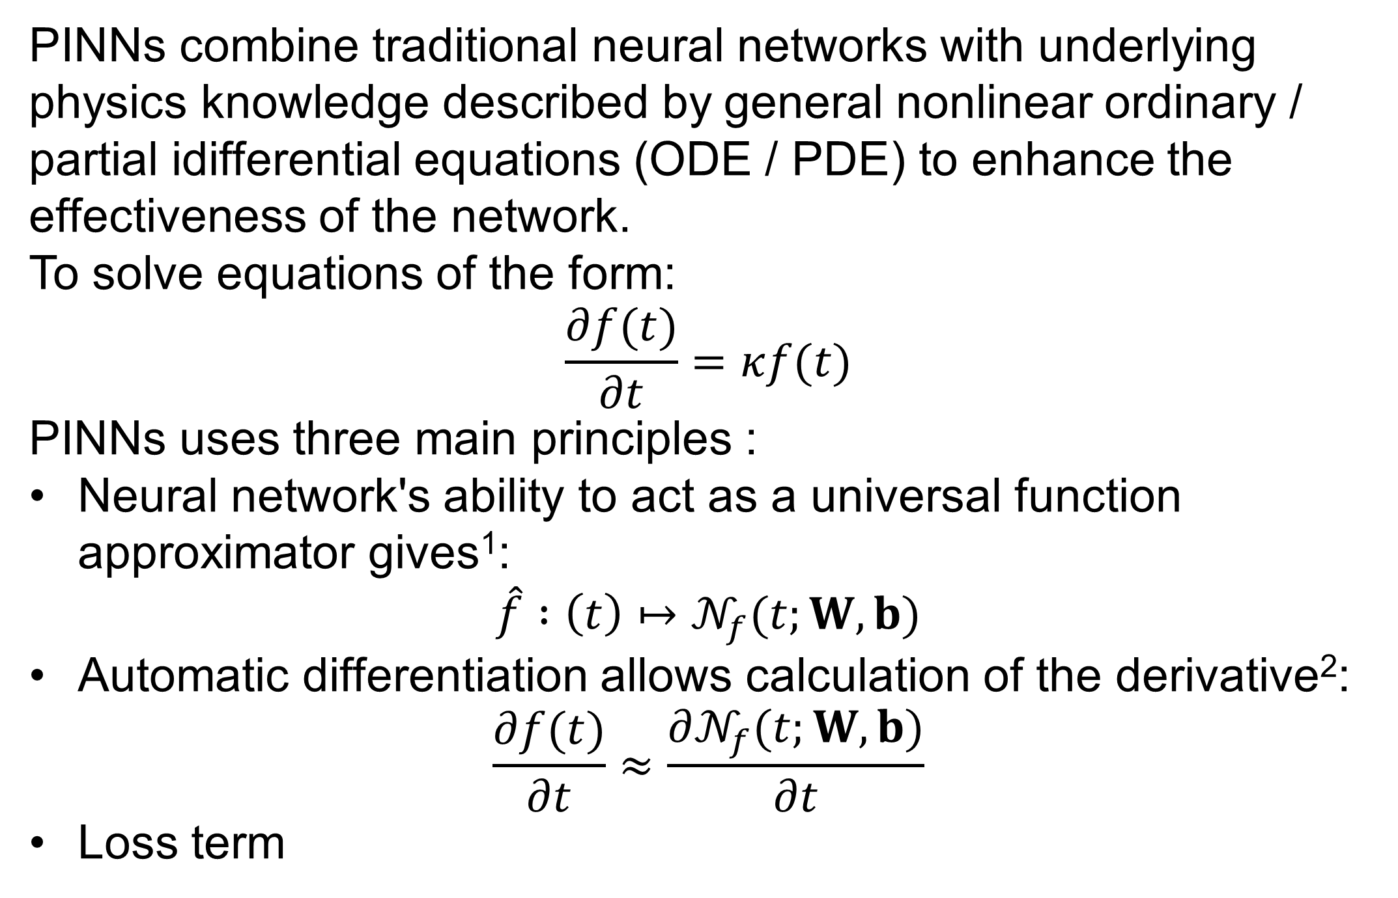
Finding a Polar Bear on Ice - Using Probabilistic Chan-Vese
02456 Deep Learning
Poster Session 8/12/2022
By: J. Hammer Hedeman and W. Sandholt Hansen
Introduction
Steps in the algorithm?
The purpose of this project is to model Covid-19 spread using physics-informed neural networks (PINN).
Initialize snake.
2. Create color and texture dictionary.
3. Create inside and outside histograms.
4. Calculate probabilities from the snake points.
5. Calculate and apply forces to snake.
6. Repeat step 3 – 5 until convergence condition is met.
Initial Conditions
Initial condition had profound effect on the results. However, even bad initial conditions gave useful results.
From left to right: Initial snake (blue) / final snake (magenta), Initial probability map, and final probability map (red = pin).
Theory
PINNs combine traditional neural networks with underlying physics knowledge described by general nonlinear ordinary / partial idifferential equations (ODE / PDE) to enhance the effectiveness of the network.
To solve equations of the form:
$$\frac{∂f(t)}{∂t}=κf(t)$$
PINNs uses three main principles :
Neural network's ability to act as a universal function approximator gives¹:
$$\hat{f} :\left(t\right)↦𝒩_{f}(t;W,b)$$
Automatic differentiation allows calculation of the derivative²:
$$\frac{∂f(t)}{∂t}≈\frac{∂𝒩_{f}(t;W,b)}{∂t}$$
Loss term
Results?
These are some of the results based on best weight between parameters.
SIRD model
The SIRD model describes the spread of an infectious disease by dividing the population (N) into the four compartments susceptible (S), infected (I), recovered (R), and dead (D) linked by coupled ODEs
SIRD ODE
$$\frac{dS}{dt} =−\left(\frac{α}{N}\right)SI$$
$$\frac{dI}{dt} =\left(\frac{α}{N}\right)SI−βI−γI$$
$$\frac{dR}{dt} =βI$$
$$\frac{dD}{dt} =γI$$
Color based
Creates a dictionary of colors in the image using K-means clustering. This extracts the most defining colors of the image. Each pixel in the image is then assigned to a cluster. This assignment is then used for the probability histogram.
Future improvements
Being able to work with multiple areas as foreground.
Minimize influence of initial conditions, such as the placement and size of the initial snake. This could be done by initialising several snakes in different position, making a probability map from each result, and use this to find the foreground.
DeVore et al. (2020)
Baydin et al. (2018)
asd
Notes:
Tekst og Streger i 100% farve – Baggrund i 90% Transparent.

